Slide 1


The Science - Faith Forum
www.iomp.org
Theistic Evolution Prospective
January 2 ,2026
Dearborn, Michigan
Ibrahim Duhaini, PhD, MHM, FIOMP, FIUPESM, DIMPCB
Sr. Medical Physicist
Karmanos Cancer Institute
Flint, Michigan, USA
www.iomp.org

Slide 2
What is Theistic Evolution?
Theistic Evolution (God‑guided evolution / evolutionary creationism)
God creates through natural laws, including evolution
Faith in God as Creator + acceptance of scientific evidence
Source: Wikipedia

Slide 3
Core Beliefs of Theistic Evolution
God is the primary cause of everything
Evolution and natural processes are secondary causes under God’s guidance
Accepts scientific consensus: age of Earth, Big Bang, natural selection
Humans uniquely created by God, including the soul
Source: Wikipedia

Slide 4
Theistic Evolution Perspective
Harmonizes science and faith
Evolution is a tool used by God for life’s diversity
Human uniqueness: soul and spiritual meaning granted by God
Science explains how, faith explains why

Slide 5
Harmonizes Science and Faith
Scientific proof
The Earth is ~4.54 billion years old, established through radiometric dating (U-Pb, K-Ar, etc.).
The universe began ~13.8 billion years ago, supported by cosmic microwave background (CMB) and expansion rate (Hubble-Lemaître law).
Evolution is supported by:
  Fossil succession & transitional species (e.g., land-water transition, early hominins).
  Genetics: shared DNA, nested hierarchy, endogenous retroviruses (ERVs) at identical genome locations across related species.
  Natural selection: observed in real time (antibiotic resistance, viral mutation, animal adaptation).

Slide 6
Harmonizes Science and Faith
Qur’anic proof
The Qur’an confirms creation through stages, compatible with gradual biological development:
  “He created you in stages (aṭwār)” (Nuh 71:14) وَقَدْ خَلَقَكُمْ أَطْوَارًا
  “Then We developed him into another creation” ( Al Mu’minon 23:14)
  ثُمَّ خَلَقْنَا ٱلنُّطْفَةَ عَلَقَةًۭ فَخَلَقْنَا ٱلْعَلَقَةَ مُضْغَةًۭ فَخَلَقْنَا ٱلْمُضْغَةَ عِظَـٰمًۭا فَكَسَوْنَا ٱلْعِظَـٰمَ لَحْمًۭا ثُمَّ أَنشَأْنَـٰهُ خَلْقًا ءَاخَرَ ۚ فَتَبَارَكَ ٱللَّهُ أَحْسَنُ ٱلْخَـٰلِقِينَ
The Qur’an invites observation of creation, not rejection of natural explanations:
  “Travel through the earth and observe how creation began” (Al Aankabout 29:20)
قُلْ سِيرُوا۟ فِى ٱلْأَرْضِ فَٱنظُرُوا۟ كَيْفَ بَدَأَ ٱلْخَلْقَ ۚ ثُمَّ ٱللَّهُ يُنشِئُ ٱلنَّشْأَةَ ٱلْـَٔاخِرَةَ ۚ إِنَّ ٱللَّهَ عَلَىٰ كُلِّ شَىْءٍۢ قَدِيرٌۭ

Slide 7
Evolution is a tool used by God for life’s diversity
Scientific proof
Speciation has been directly observed (Darwin’s finches, fruit flies, cichlid fish diversification).
Comparative anatomy (homology) shows shared structural designs modified by function, not isolated independent origin.
Genomic evidence reveals a consistent evolutionary tree where mutations accumulate gradually under environmental pressure.

Slide 8
Evolution is a tool used by God for life’s diversity
Qur’anic proof
The Qur’an attributes every mechanism in nature to Allah’s creative command, including systems we later discover scientifically:
  “Indeed, His command when He wills a thing is only to say to it ‘Be’, and it is.” (Ya seen 36:82) إِنَّمَآ أَمْرُهُۥٓ إِذَآ أَرَادَ شَيْـًٔا أَن يَقُولَ لَهُۥ كُن فَيَكُونُ
  “Allah is the Best of Creators.” (Al Mu’minoon 23:14) فَتَبَارَكَ ٱللَّهُ أَحْسَنُ ٱلْخَـٰلِقِينَ
The Qur’an explicitly states all creatures were created from a common origin—water, aligning with life emerging from an initial biological system:
  “We made from water every living thing” (Al Anbyaa 21:30) وَجَعَلْنَا مِنَ ٱلْمَآءِ كُلَّ شَىْءٍ حَىٍّ ۖ
  “Allah created every creature from water” (An Noor 24:45) وَٱللَّهُ خَلَقَ كُلَّ دَآبَّةٍۢ مِّن مَّآءٍۢ ۖ

Slide 9
Human uniqueness: soul and spiritual meaning granted by God
Scientific proof
Humans share biological ancestry with other primates, but are distinguished by:
  Advanced prefrontal cortex → reasoning, ethics, planning.
  Symbolic language → culture, abstract thought.
  Moral agency → capacity to form civilizations, laws, moral systems.
  Self-awareness → demonstrated in neurology, cognition, psychology.

Slide 10
Human uniqueness: soul and spiritual meaning granted by God
Qur’anic proof
The Qur’an confirms that Adam’s body was formed, then the soul was added by Allah, marking a distinct non-biological component of human origin:
  “Then He fashioned him and breathed into him from His Spirit (the soul)” ( Al Sajdah 32:9) ثُمَّ سَوَّىٰهُ وَنَفَخَ فِيهِ مِن رُّوحِهِۦ ۖ
  “When I have shaped him and breathed into him of My Spirit, fall down before him in prostration” (Al Hijir 15:29) فَإِذَا سَوَّيْتُهُۥ وَنَفَخْتُ فِيهِ مِن رُّوحِى فَقَعُوا۟ لَهُۥ سَـٰجِدِينَ
The Qur’an grants humans a unique status beyond biology:
  “We have certainly honored the children of Adam” (Al Israa 17:70) وَلَقَدْ كَرَّمْنَا بَنِىٓ ءَادَمَ will place a vicegerent (khalīfa) on Earth” ( Al Baqara 2:30) إِنِّى جَاعِلٌۭ فِى ٱلْأَرْضِ خَلِيفَةًۭ ۖ

Slide 11
Science explains how, faith explains why
Scientific proof
Evolution explains HOW:
  Genetic variation → mutation + recombination.
  Environmental pressure → natural selection.
  Gradual adaptation → anatomical and genomic changes over generations.
  Biodiversity → branching speciation and inherited traits.
This is a mechanistic explanation, not a claim about purpose or ultimate causation.

Slide 12
Science explains how, faith explains why
Qur’anic proof
Islam explains WHY:
  Creation has intentional purpose, not randomness:
    “We did not create the heavens and the earth and everything between them without purpose.” (Sa’d 38:27) وَمَا خَلَقْنَا ٱلسَّمَآءَ وَٱلْأَرْضَ وَمَا بَيْنَهُمَا بَـٰطِلًۭا ۚ
    “Do you think We created you without purpose and that you would not return to Us?” ( Al- Mou’minoon 23:115) أَفَحَسِبْتُمْ أَنَّمَا خَلَقْنَـٰكُمْ عَبَثًۭا وَأَنَّكُمْ إِلَيْنَا لَا تُرْجَعُونَ
  Allah governs existence and meaning; humans are created for recognition of God, moral responsibility, and spiritual return.

Slide 13
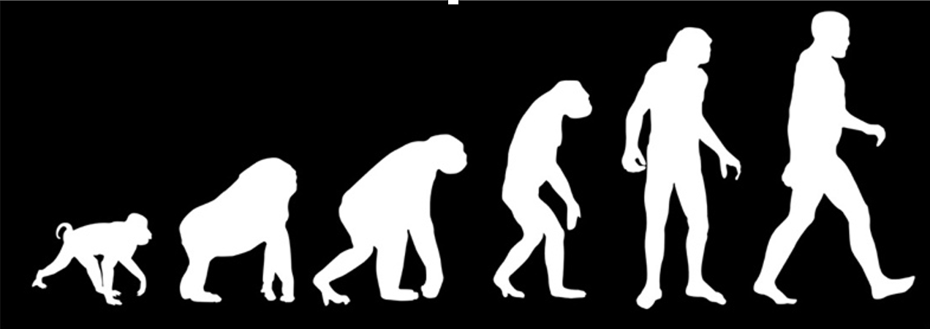
The image wrongly suggests humans evolved in a straight line from monkey → chimp → caveman → modern human.
It reinforces the false belief that humans descended from existing primates, instead of evolving alongside them.
The truth is that humans and other primates share a common ancestor, and none evolved directly from the other.
The graphic is historically based on Rudolph Franz Zallinger’s “March of Progress / Road to Homo sapiens”.
Because of its misleading message, the image has caused more misunderstanding than clarity in explaining evolution.
Source: Prosanta Chakrabarty, https://thereader.mitpress.mit.edu/is-our-picture-of-evolution-still-stuck-in-the-past/

Slide 14
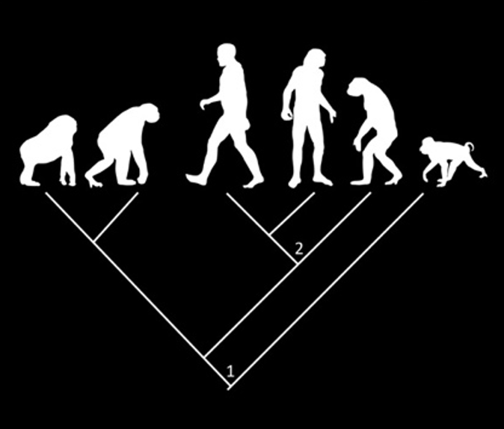
Evolution is best represented by a phylogenetic tree, not a linear sequence.
Species on branches are relatives, not direct ancestors.
Ancestors are shown at the nodes, where branches split.
The tailed monkey is a close relative to the other primates, not their ancestor.
Node 1 = common ancestor of all six primates, including humans.
Node 2 = common ancestor of chimps, modern humans, and extinct human species.
Source: Prosanta Chakrabarty, https://thereader.mitpress.mit.edu/is-our-picture-of-evolution-still-stuck-in-the-past/

Slide 15
Conclusion
Theistic evolution bridges faith and science
God works through natural processes
Spiritual meaning + scientific inquiry can coexist

Slide 16
Summary
Theistic Evolution presents a harmonious model where faith and science complement, not contradict, each other.
God (Allah) is the primary cause, and evolution is one of the natural laws He uses to unfold life’s diversity.
Evolution explains how life changes and branches over time through genetics and environmental adaptation.
The Qur’an supports a gradual, staged unfolding of creation, encouraging reflection and scientific observation.
Humans did not evolve from existing monkeys or chimps—we share a common ancestor with them.

Slide 17
Summary
Linear “progression” graphics are misleading; phylogenetic trees better show true relationships, with nodes representing ancestors.
Human uniqueness is spiritual, not just biological—God grants the soul, moral agency, and purpose.
Science answers the question how, while faith answers why—both are necessary for a complete worldview.
Respectful dialogue across perspectives enriches understanding and strengthens appreciation of the Creator.

Slide 18
Takeaways
Creation has a system, and it has a purpose.
Science reveals the system. Faith reveals the purpose.
Theistic Evolution unites them under One Creator.

Slide 19
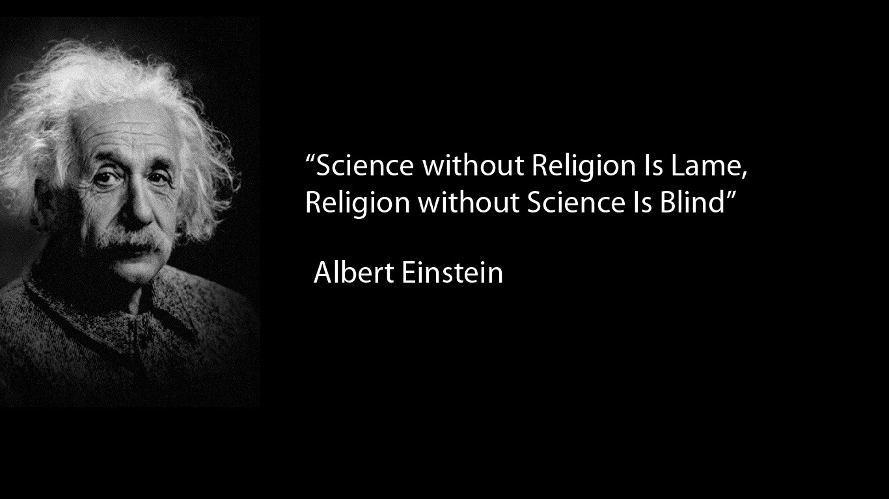
"العلم بدون دين أعرج، والدين بدون علم أعمى."
THANK YOU

