Slide 1

Is Evolution God’s Plan for Creation
A Dialogue Between Faith and Science
Science should not be treated as a belief
Notes:
TIMING: 1 minute
CUE: Pause after title. Smile. Invite curiosity.
VISUAL CUE: Soft fade-in transition from black (2 seconds)
SPEAKER NOTES:
Good evening everyone,
Thank you for being here and for engaging in a conversation that has challenged thinkers, scientists, theologians, and philosophers for more than a century. Tonight's topic—"Is Evolution God's Plan for Creation?"—is not merely a scientific question, nor solely a theological one. It is a deeply human question, touching on meaning, purpose, identity, and our place in the universe.
Rather than framing this as a debate between winners and losers, I invite us to see it as a dialogue—one that asks not only how life developed, but why such a universe exists at all.

Slide 2

Why This Conversation Matters
• Science and faith are often framed as enemies
• People feel forced to choose sides
• Reality is far more nuanced
Notes:
TIMING: 1 minute
CUE: Invite reflection—'Have you ever felt forced to choose?'
VISUAL CUE: Bullets appear one by one with "Wipe from Left" effect (0.5 sec each)
SPEAKER NOTES:
This conversation matters because across universities, places of worship, dinner tables, and classrooms, science and faith are often presented as incompatible opposites. Students feel they must choose between intellectual honesty and spiritual belief. But this false binary diminishes both domains. The reality is far more complex, intellectually rich, and spiritually meaningful than either extreme position suggests.

Slide 3
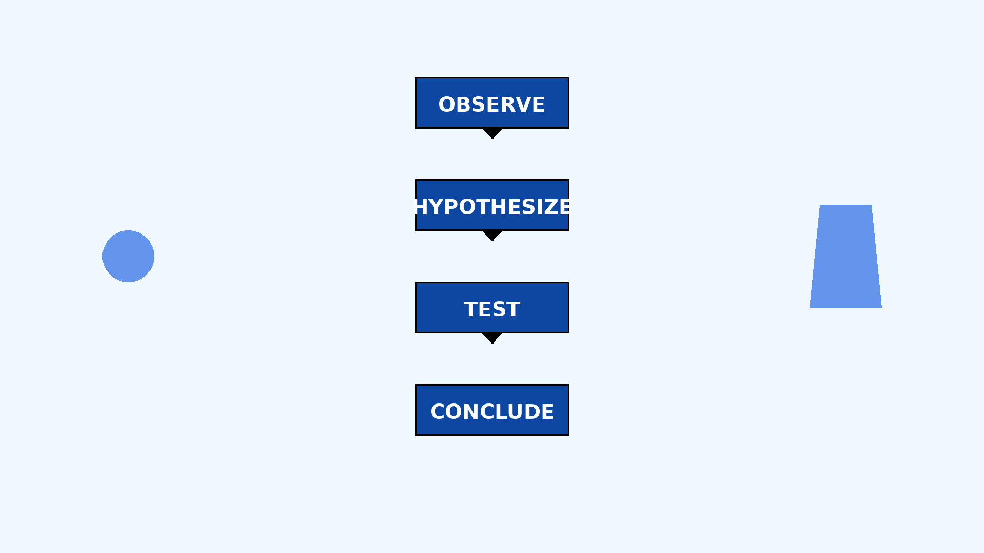
Science Should Not Be Treated as a Belief
• Science is a method, not a worldview
• It asks how, not why
• It is self-correcting and evidence-based
Notes:
TIMING: 1.5 minutes
CUE: Pause after 'method'. Emphasize the humility of science.
VISUAL CUE: Each bullet point appears with "Float In" effect
SPEAKER NOTES:
Let us begin with what science tells us. Evolution, as described by modern biology, is the process by which life changes over time through mechanisms such as mutation, natural selection, and genetic variation. This framework has overwhelming empirical support—from fossil records and comparative anatomy to genetics and molecular biology.
For many scientists, evolution is not a worldview—it is a method. It answers the question: How does life change? But science, by its very nature, does not ask why the universe exists in the first place or whether life has ultimate meaning. These questions lie beyond the scope of empirical measurement.

Slide 4

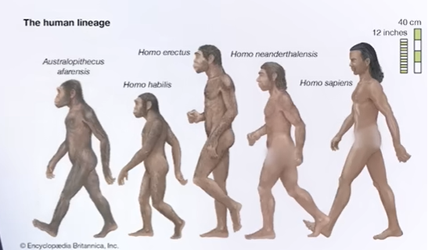
What Science Explains
• Evolution explains biological diversity
• Natural selection and genetics
• Supported by fossils and DNA
Notes:
TIMING: 1 minute
CUE: Keep tone explanatory, not defensive.
VISUAL CUE: Bullets appear with "Grow & Turn" effect
SPEAKER NOTES:
Evolution explains how life diversified, how species adapt, and how complex biological systems emerge over vast timescales. It does not rely on supernatural explanations; rather, it operates within the observable and testable laws of nature. From the finches of the Galápagos(usually refers to Darwin’s finches) to antibiotic resistance in bacteria, we observe evolution in action. The genetic code itself reveals our shared ancestry with all living things.

Slide 5

What Science Does NOT Claim
• Does not define meaning
• Does not deny God
• Does not provide moral purpose
Notes:
TIMING: 1 minute
CUE: Slow down; this slide reframes tension.
VISUAL CUE: Bullets fade up slowly (0.8 sec each)
SPEAKER NOTES:
Science does not claim to answer why we exist, whether life has ultimate purpose, or what moral principles should guide us. It doesn't deny God—it simply doesn't require that hypothesis to explain biological mechanisms. Scientific knowledge tells us how stars form, how cells divide, how species change—but it doesn't tell us whether to call existence beautiful, whether to worship, or how to live a meaningful life.

Slide 6

The Theistic Perspective
• Creation as purposeful
• God works through natural laws
• Evolution as a tool, not a threat
Notes:
TIMING: 1.5 minutes
CUE: Emphasize harmony, not conflict.
VISUAL CUE: Bullets appear with "Shape" entrance effect
SPEAKER NOTES:
From a theistic perspective, particularly within Jewish, Christian, and Islamic traditions, at least for Abrahamic faith creation is understood as purposeful—rooted in divine intention. Some believers interpret sacred texts literally, seeing creation as a direct and immediate act of God. Others adopt a more symbolic or theological reading, understanding sacred texts as conveying truths about meaning, relationship, and moral order rather than scientific mechanisms.
Theistic evolution—sometimes called evolutionary creation—bridges these views. It holds that God is the ultimate source of creation but works through natural laws, including evolution. In this view, evolution does not replace God; it describes how God creates.

Slide 7

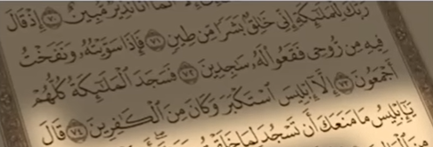
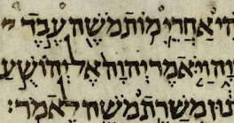
Scripture and Meaning
• Literal vs symbolic readings
• Focus on purpose, not mechanics
Notes:
TIMING: 1 minute
CUE: Invite reflection, avoid polemics.
VISUAL CUE: Book pages turn with "Page Curl" effect, bullets fade in sequentially
SPEAKER NOTES:
Random mutation, for example, may appear random from a scientific standpoint, but randomness does not necessarily mean purposelessness. A process can appear stochastic while still unfolding within a larger intentional framework. Just as a master artist may use seemingly random brush strokes to create a unified vision, so too might natural processes serve a greater purpose.

Slide 8

The Naturalistic Perspective
• Nature explains itself
• Meaning is human-constructed
• Awe in natural law
Notes:
TIMING: 1 minute
CUE: Respectful tone—no caricatures.
VISUAL CUE: Images cross-fade in background, bullets appear with "Swivel" effect
SPEAKER NOTES:
From an anti-theistic or strictly naturalistic view, evolution is sufficient on its own. There is no need to invoke a divine being to explain life's diversity or complexity. Advocates of this position often argue that introducing God into scientific explanations is unnecessary and potentially hinders inquiry. For them, meaning is not discovered from above but constructed by human experience, ethics, and culture.
This perspective emphasizes intellectual humility—acknowledging that humans are the product of natural processes, not the center of the universe??. It often finds awe not in divine intention but in the elegance of natural laws themselves(At least both perspectives converge when quoting Einstein: “I’m in awe before the harmony of the cosmos”).

Slide 9
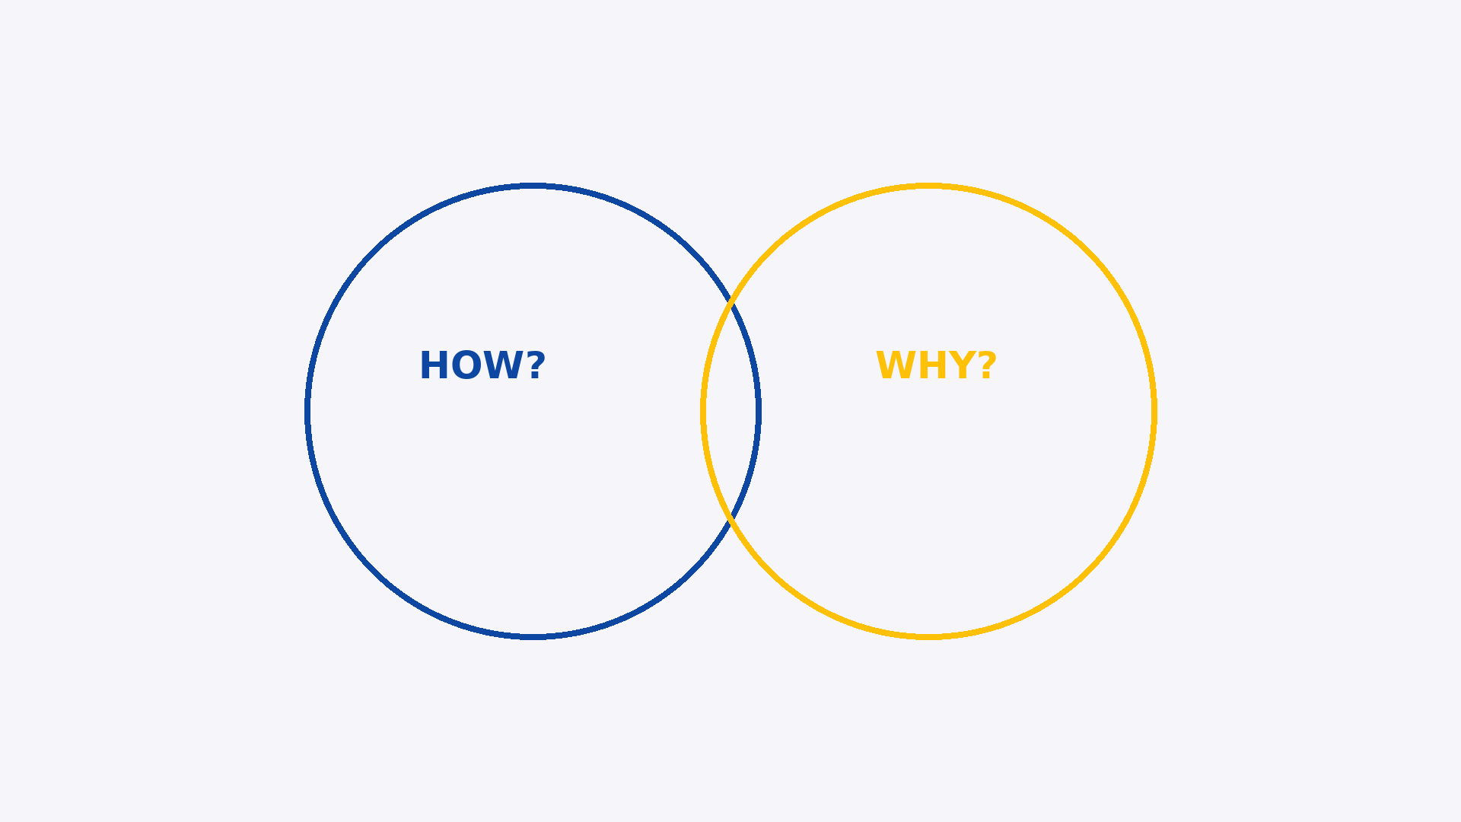
Where the Tension Lies
• Science asks how
• Faith asks why
• Confusion creates conflict
Notes:
TIMING: 1 minute
CUE: Gesture between two sides.
VISUAL CUE: Bullets alternate from left and right, diagram components build progressively
SPEAKER NOTES:
The real tension between these views is not science versus faith—it is interpretation versus meaning.
Science asks: What mechanisms caused this? Can it be tested? Can it be falsified?
Faith asks: Why is there something rather than nothing? Why does the universe follow intelligible laws? Why do humans seek meaning, morality, and transcendence?
Conflict arises when one domain is forced to answer questions it was never designed to address.

Slide 10

Compatibility Is Possible
• Science explains how
• Faith explores why
• Both require humility
Notes:
TIMING: 1 minute
CUE: Smile, hopeful tone.
VISUAL CUE: Bullets appear with "Rise Up" effect, integration graphic forms piece by piece
SPEAKER NOTES:
Many thinkers—scientists, philosophers, and theologians alike—argue that science and faith are not enemies but partners addressing different dimensions of reality.
Science explains how the universe works.
Faith explores why it exists and what it means.
To say that evolution is God's plan does not require rejecting science. Nor does accepting evolution require rejecting God. The real challenge lies in humility—recognizing the limits of both scientific certainty and theological interpretation.

Slide 11
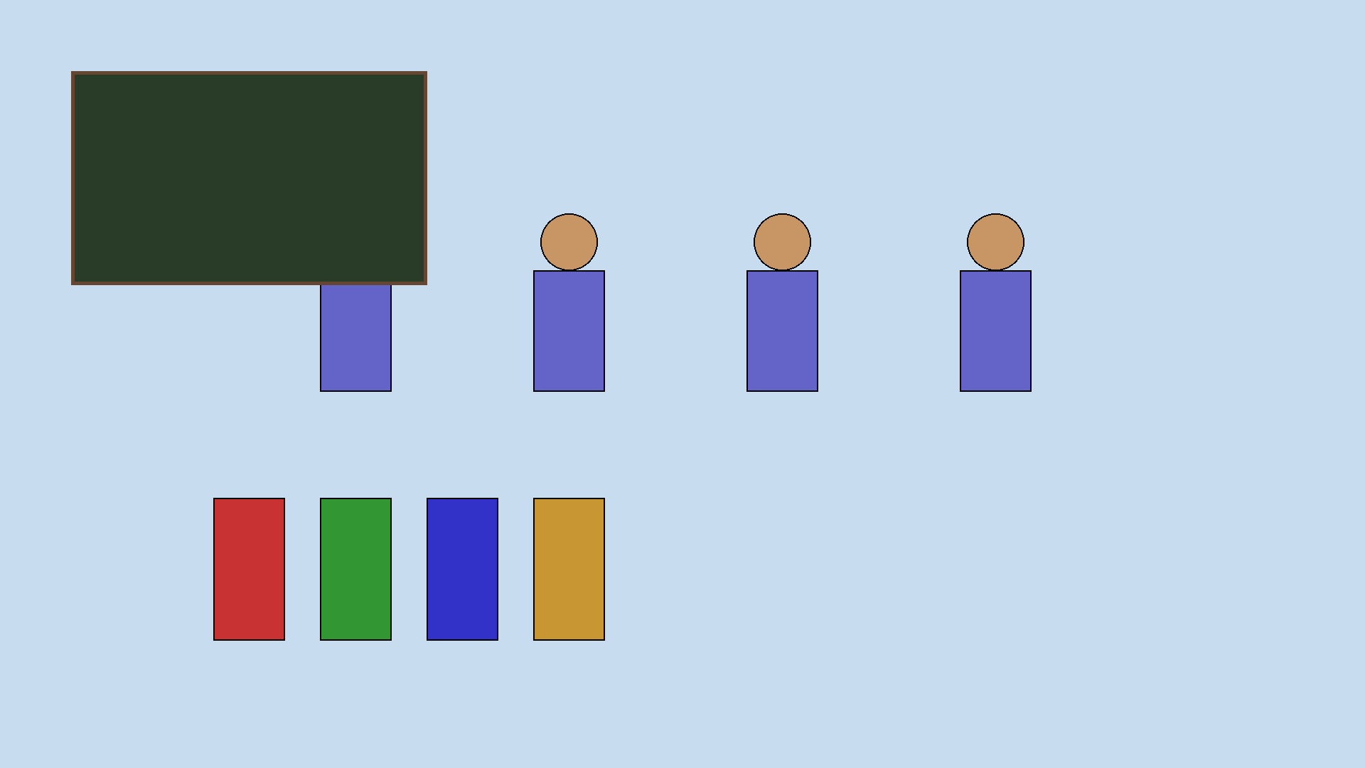
Why This Matters in Education
• Encourage curiosity
• Avoid false choices
• Foster respectful dialogue
Notes:
TIMING: 1 minute
CUE: Emphasize students and learning.
VISUAL CUE: Bullets appear with "Bounce" effect
SPEAKER NOTES:
For educators, this conversation matters deeply. Students today are often forced into false binaries: science or faith, reason or belief, evidence or meaning.
But education thrives when students are allowed to wrestle with complexity, to hold tension, and to think critically without fear of dismissal. Encouraging respectful dialogue equips students not only with knowledge, but with wisdom.
This can be dismissed ……Redundancy!!!!!! We must create spaces where young minds can explore evolution without feeling they must abandon their spiritual heritage, and spaces where faith communities can embrace scientific discovery without fear of losing their foundation.

Slide 12
synthesis honors both empirical truth and spiritual depth
Evolution is creation in motion.
Randomness is not chaos, but freedom built into the fabric of life.
The emergence of consciousness marks creation becoming aware of itself.

Slide 13

Closing Reflection
• The universe is intelligible
• Curiosity unites us
• Seek understanding, & positivism
Notes:
TIMING: 1 minute + sustained pause
CUE: Pause. Let silence land. End with sustained pause on final slide.
VISUAL CUE: Bullets fade in slowly (1.2 sec each), final image zooms out gently showing vastness
SPEAKER NOTES:
Whether one believes evolution is guided by divine purpose or shaped solely by natural processes, one truth remains: the universe is profoundly intelligible, and humanity has the remarkable capacity to explore it.
Perhaps the deepest question is not whether evolution is God's plan, but whether we are willing to approach both science and faith with humility, curiosity, and openness.
As we continue this conversation, may we seek understanding, positivism, and truth—wherever it leads.
Thank you.

